Slide 1
Front-End Web Development Using React (Client Side Technologies - CSS)
Front-End Web Development Using React – CSS
Eng. Reem Hassan Ahmed

Slide 2
Contents of this lecture
Introduction to CSS | What is CSS?
CSS selector types | Definition and exmaples on all css selector types
CSS properties | Definition and exmaple on every CSS property

Slide 3
01
Introduction to CSS
Front-End Web Development Using React – CSS

Slide 4
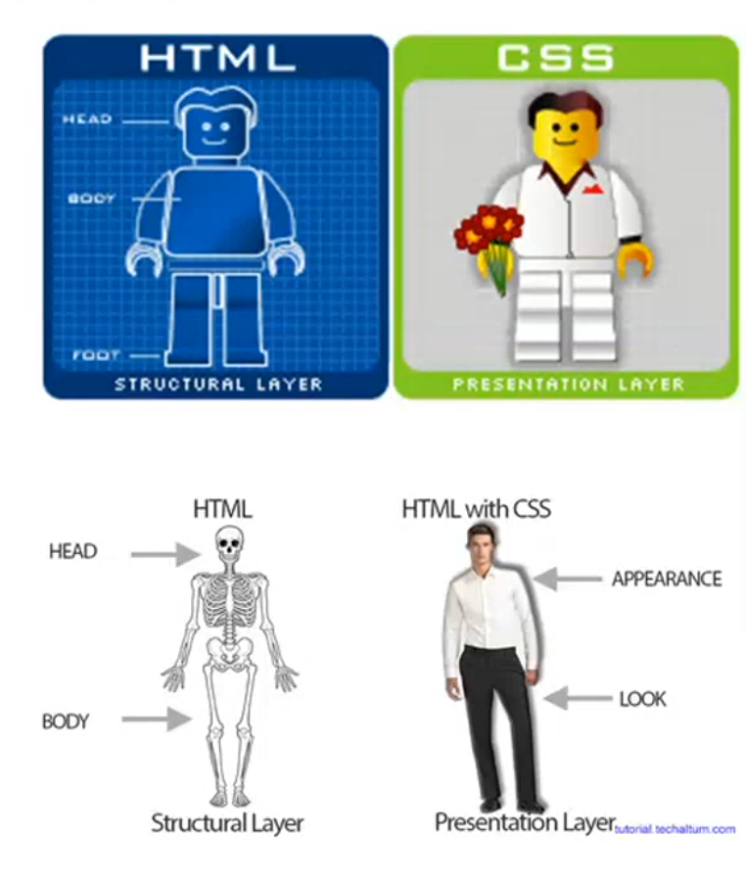
Introduction to CSS
CSS describes how HTML elements are to be displayed on screen, paper, or in other media
CSS stands for cascading stylesheets.
While HTML is the structure of the web page, CSS is responsible for the presentation of that structure.

Slide 5
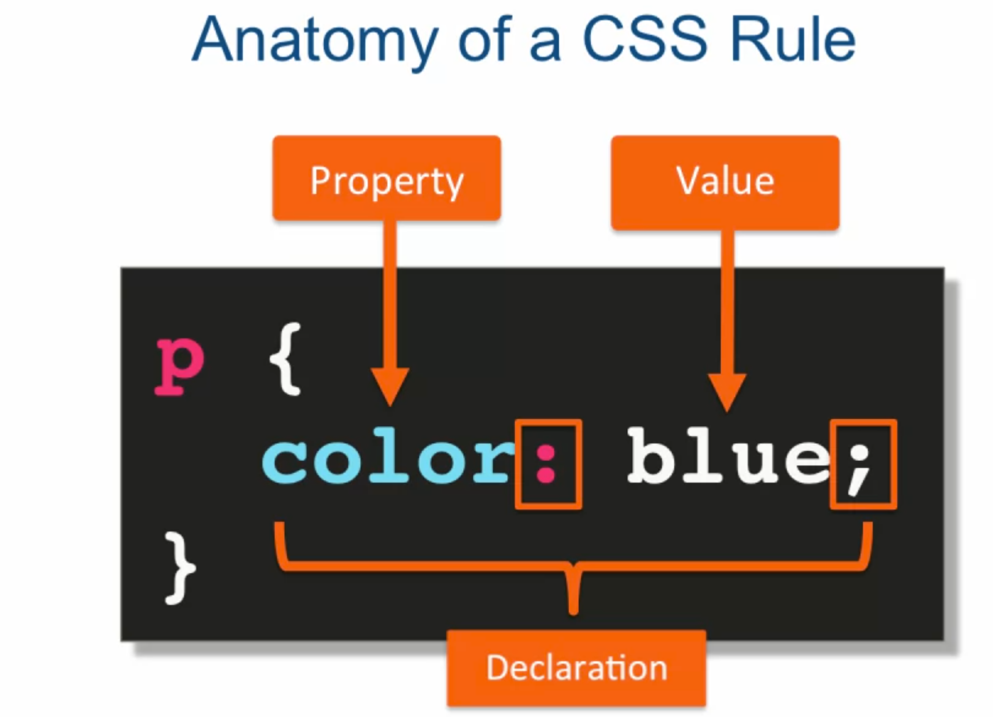
Introduction to CSS
Selector

Slide 6
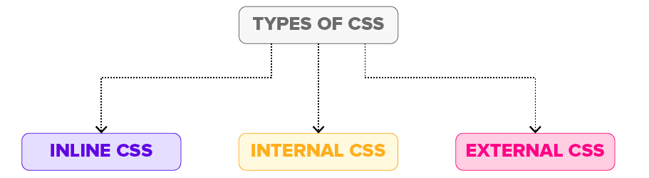
Types of styling

Slide 7
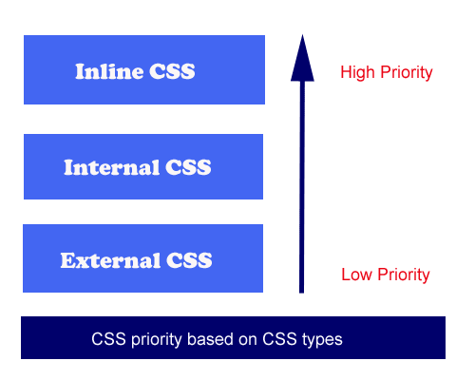
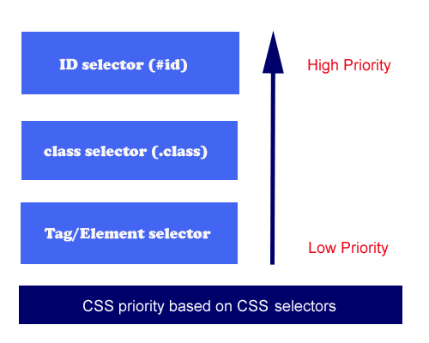
CSS Priority

Slide 8
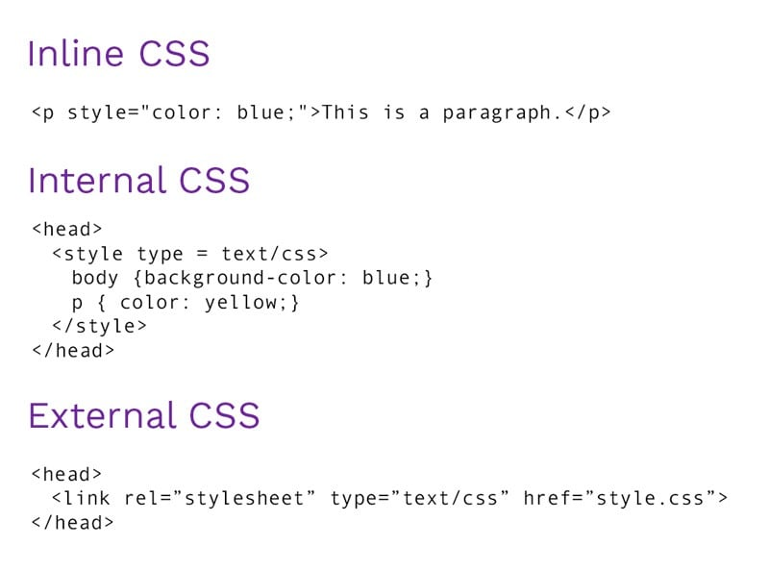
Types of styling Cont.
Internal CSS: <style> tag used in the head section inside the HTML file.
External CSS: Styles are in an external style sheet that is linked to the HTML file using the <link> tag that is placed in the head section.

Slide 9
02
CSS selector types
Front-End Web Development Using React – CSS

Slide 10
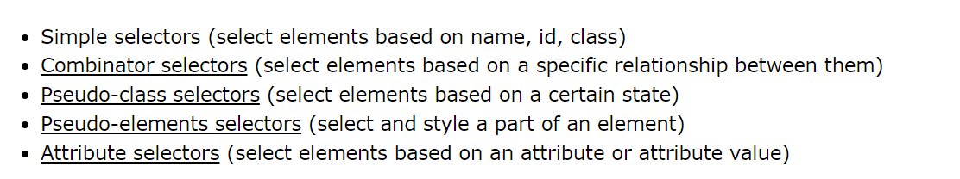
CSS selector types

Slide 11
CSS selector types Cont.
Combinator selectors:
descendant selector (space) : matches all elements that are descendants of a specified element.
child selector (>) : selects all elements that are the direct children of a specified element.
adjacent sibling selector (+) : Select the first element after the specified element.
general sibling selector (~) :selects all elements that are next siblings of a specified element.

Slide 12
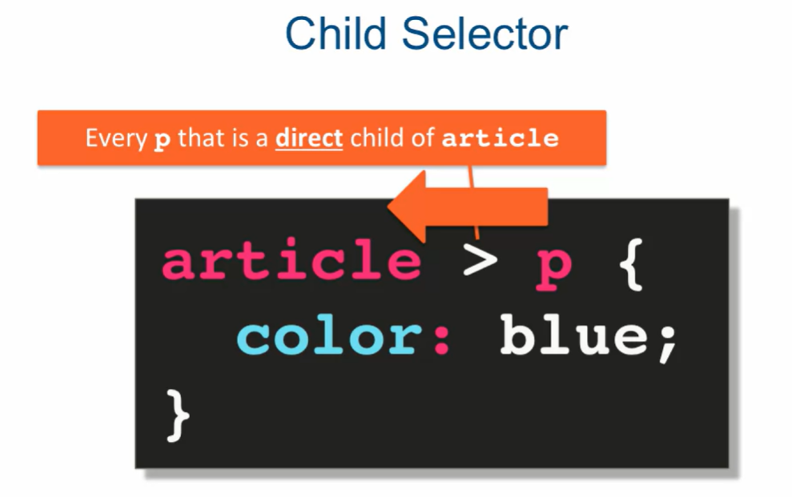
CSS selector types Cont.
Combinator selectors:

Slide 13
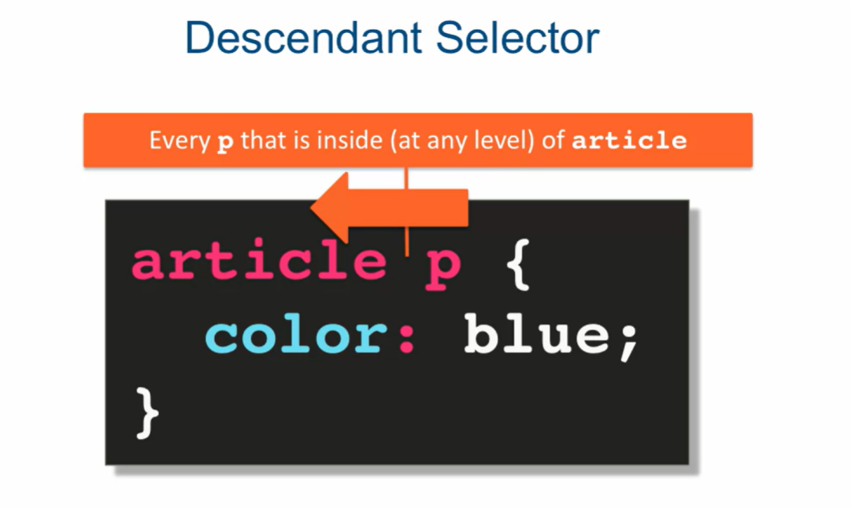
CSS selector types Cont.
Combinator selectors:

Slide 14
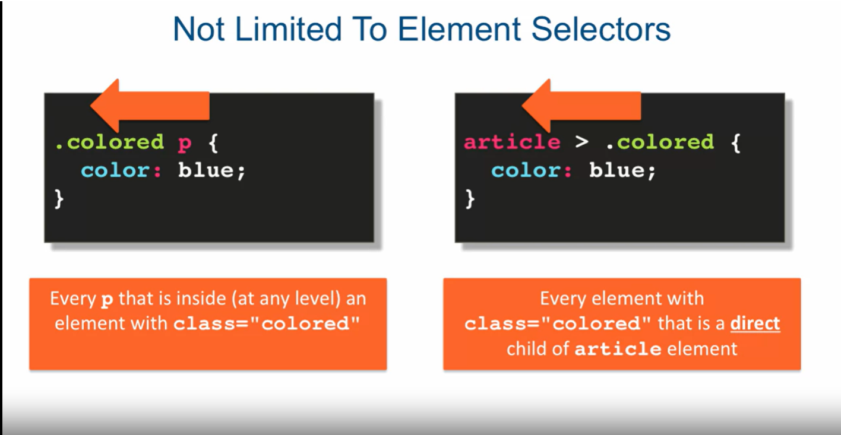
CSS selector types Cont.
Combinator selectors:

Slide 15
03
CSS properties
Front-End Web Development Using React – CSS

Slide 16
Table of contents
01
Backgrounds
04
Text
07
Display
02
Borders
05
Fonts
08
Position
03
Margin and padding
06
Lists
09
Forms

Slide 17
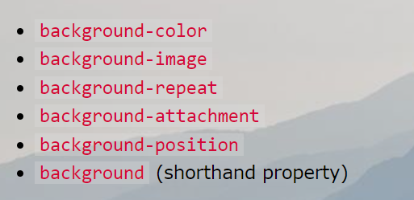
Backgrounds

Slide 18
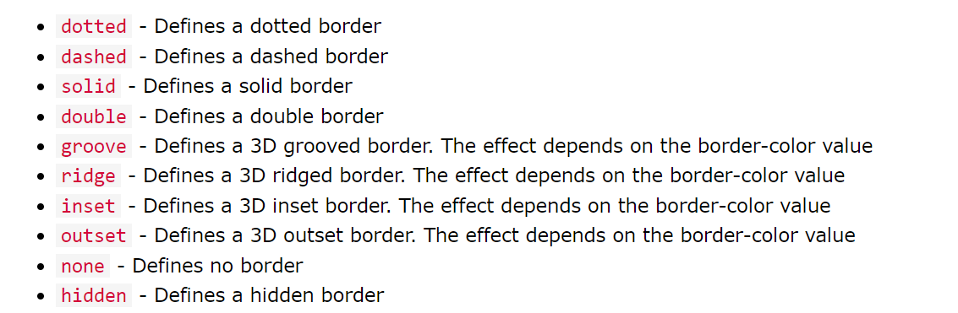
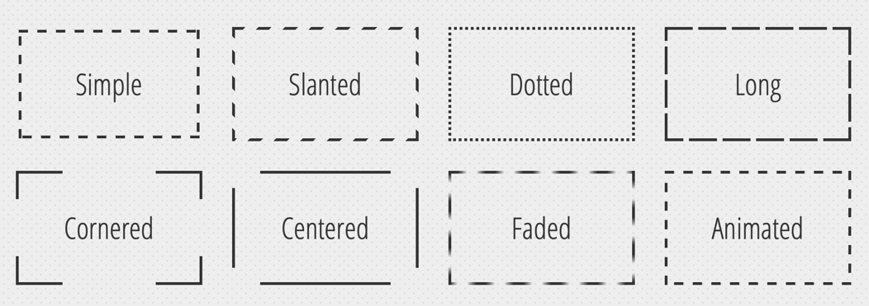
Borders

Slide 19
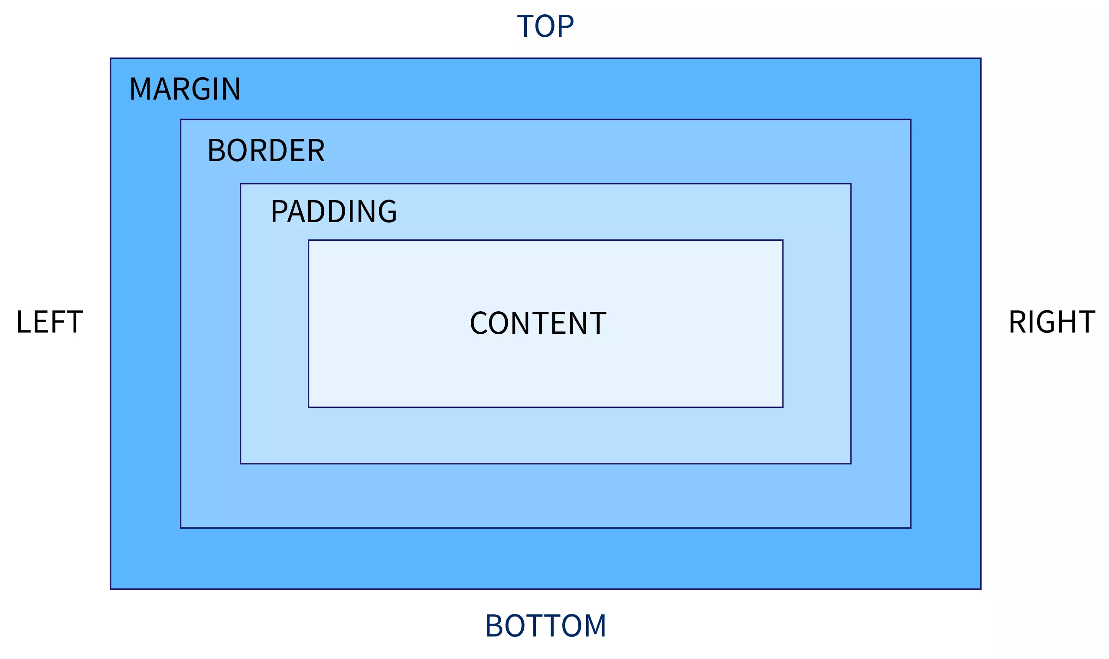
Margins and Padding
Margins are used to create space around elements, outside of any defined borders.
Padding is used to create space around an element's content, inside of any defined borders.

Slide 20
Thanks!
Front-End Web Development Using React – CSS
Does anyone have any question?
ReemHassan160299@gmail.com
+201092427577
Please keep this slide for attribution

